Slide 1
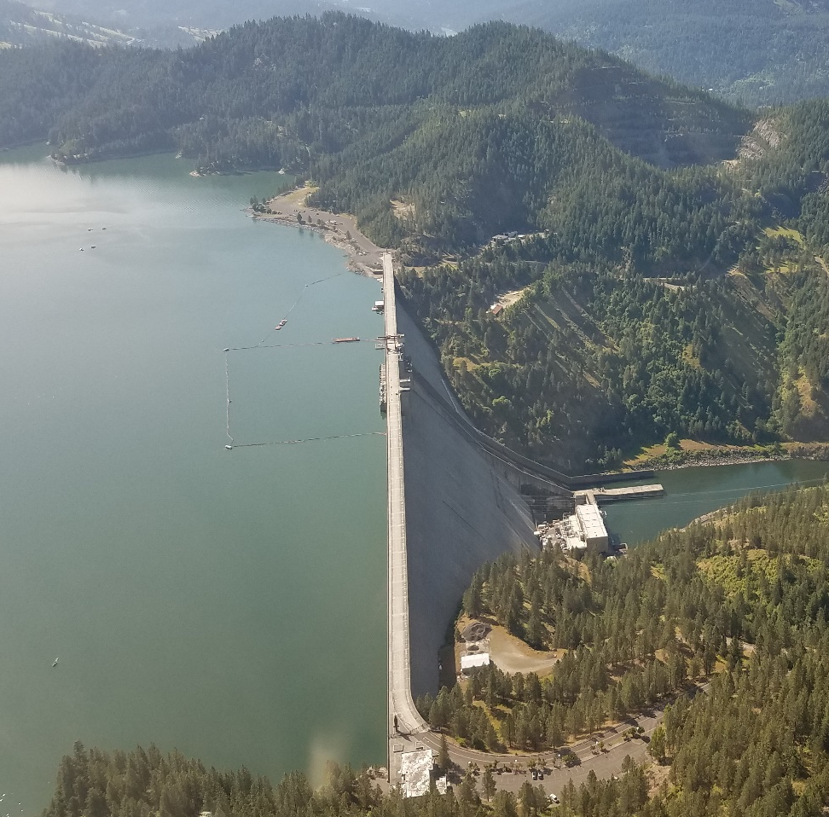
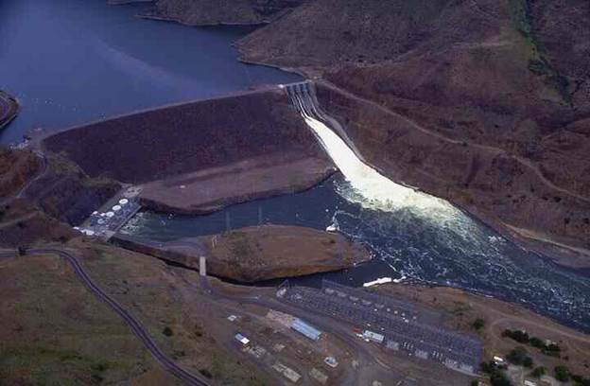
CWMS LOWER SNAKE
ESP Development
Walla Walla District
Developed by:
  Jon Roberts, PE
  Ross Wickham, PE

Slide 2
Overview
Lower Snake watershed and points of emphasis
CWMS goals
Vision for the ESP ensemble compute
Initial workflow priorities, timeline, and work completed
Real-time results
Next steps
Future improvements & partnership
Questions

Slide 3
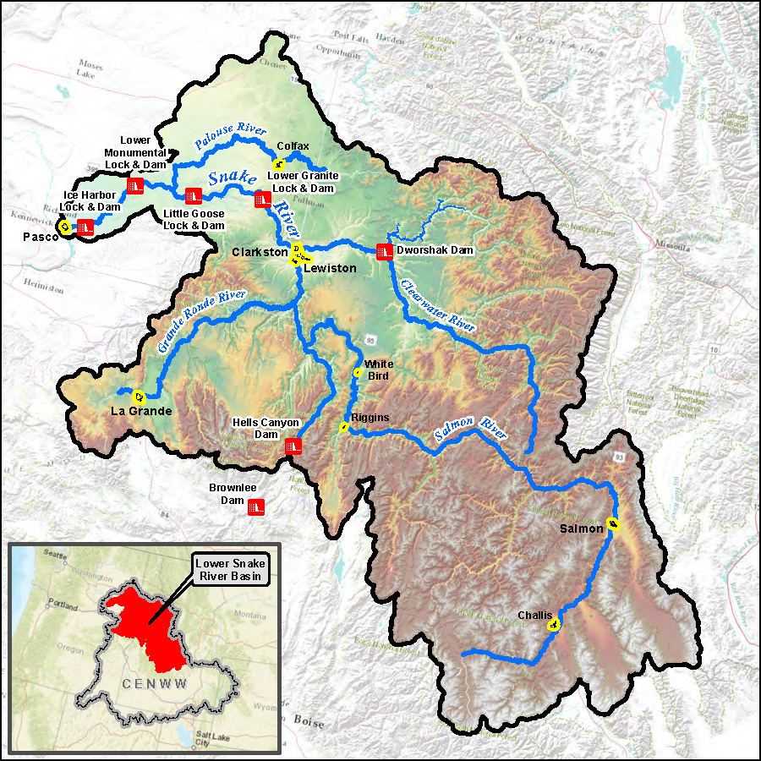
CWMS Lower Snake Watershed
Lower Snake
8 Reservoirs
35,049sq miles
5 Major consequence locations
3 Significant levee systems
River Miles Modeled:
  Snake River: 237mi
  Clearwater River: 45.5mi

Slide 4
CWMS Goals for Lower Snake
Incorporate/Expand upon the CWMS Clearwater model
Provide WM a model that had reservoir operations capable of handling water temperature and momentum wave action once software was ready
Provide a more diverse time range for operations
  Current District CWMS uses 10-day gridded QPF
  Upgrade CWMS Clearwater model to incorporate 10d-RFC feeds
  Only really useful in 2 timeframes of the WY
      Rain-on-Snow events
      Final Fill events

Slide 5
Vision for the ESP Ensemble
Utilizing RFC 120-day STP run, as a risk base analysis for runoff
This led to the idea of re-regulating the complete ESP data record from the raw dataset
Advantages
  Relying on the RFC expertise for the hydrology but WM staff for the regulations of the projects
  Allows WM staff to identify more applicable runoff alternatives based on current runoff-volume forecast for each of the reservoirs
  Provides a risk analysis range for possible runoffs
  Allows for the overlay plot of specific analog ESP years, to view for comparisons
  Allows for the use of updated routing from current calibrated HEC-RAS model

Slide 6
Workflow ESP Ensemble Development
Build ResSim alternative
Data from RFC forecast points
Backing out local inflows for the RFC points
Creating inflow data for critical locations without RFC points
CAVI setup
Mapping time-specific data to current CAVI forecast
Real-time testing
Weighting of WY based on volume forecast
Graphing interface

Slide 7
ResSim: ESP Network Setup
Palouse at Hooper
LMN
IHR
DWR
Potlatch
LWG
LGS
Spalding
Orofino
Tucannon near Starbuck
Asotin Ck
Anatone
Lapwai Ck
Grande Ronde at Troy
Salmon at Whitebird
RFC Routing Reach
ResSim Model Reach
Reach Not Modeled
Imnaha
Hells Canyon
RFC Forecast Location
Oxbow
CCP Inflow Location
Non-RFC Forecast Location; inflows to be computed in relation to RFC Location
Brownlee

Slide 8
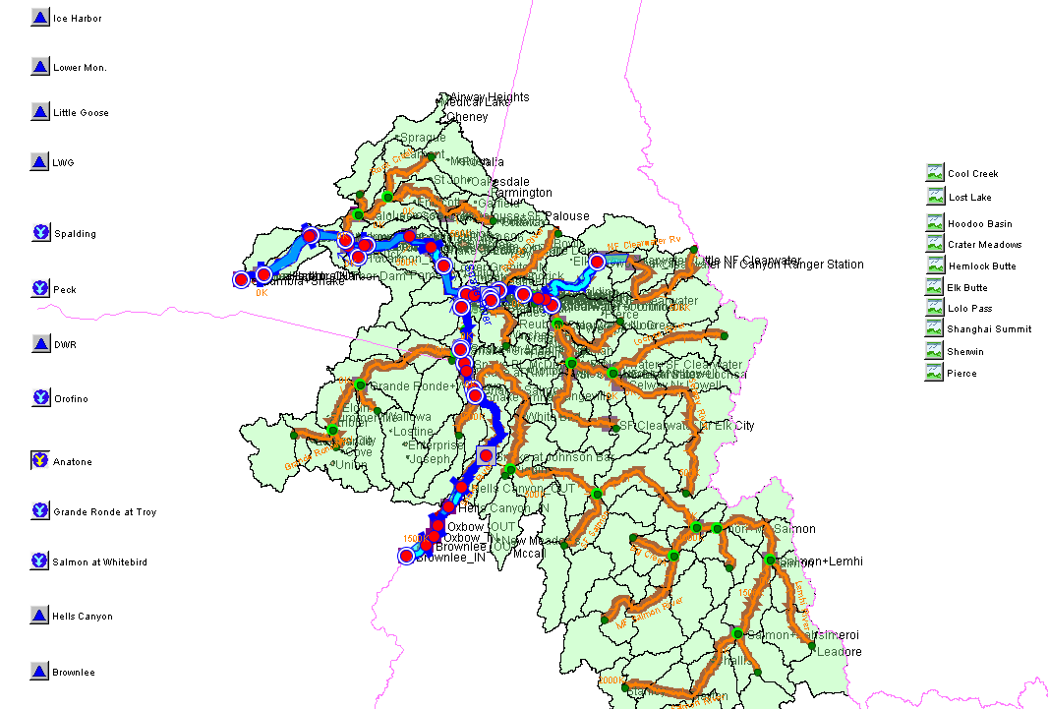
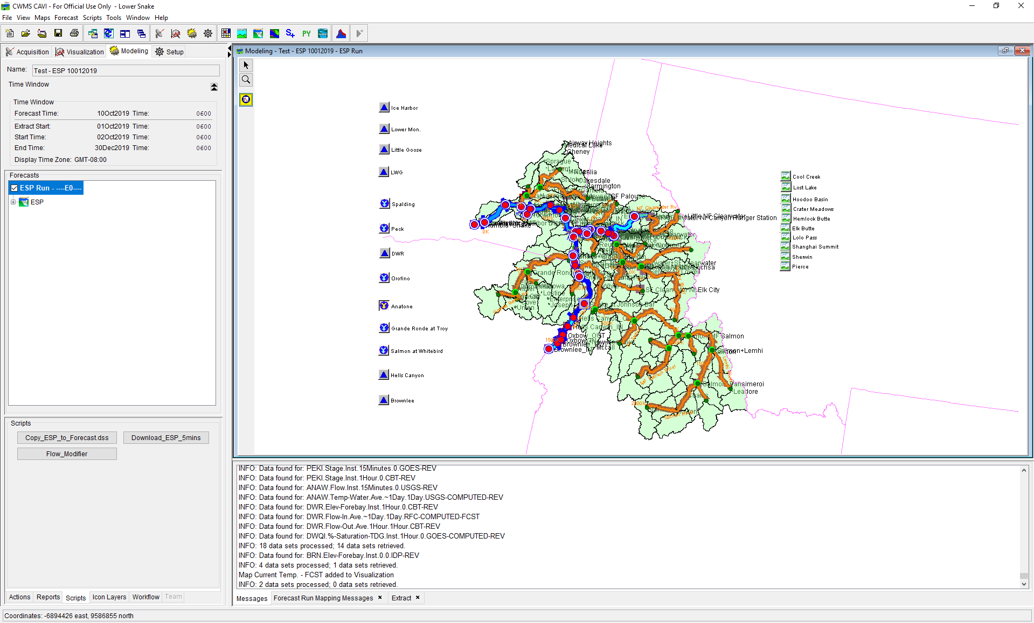
CAVI Setup and Initial Results

Slide 9
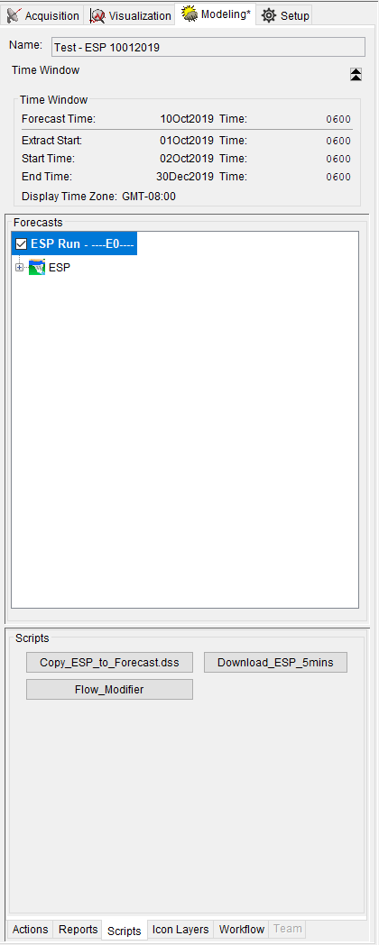
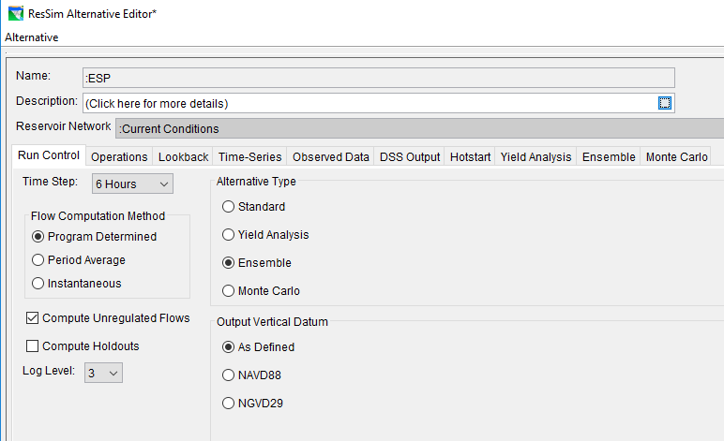
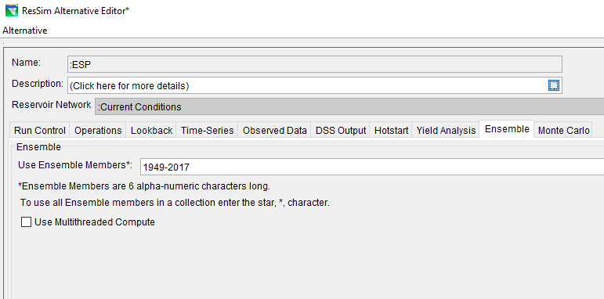
CAVI Forecast and ResSim Alternative

Slide 10
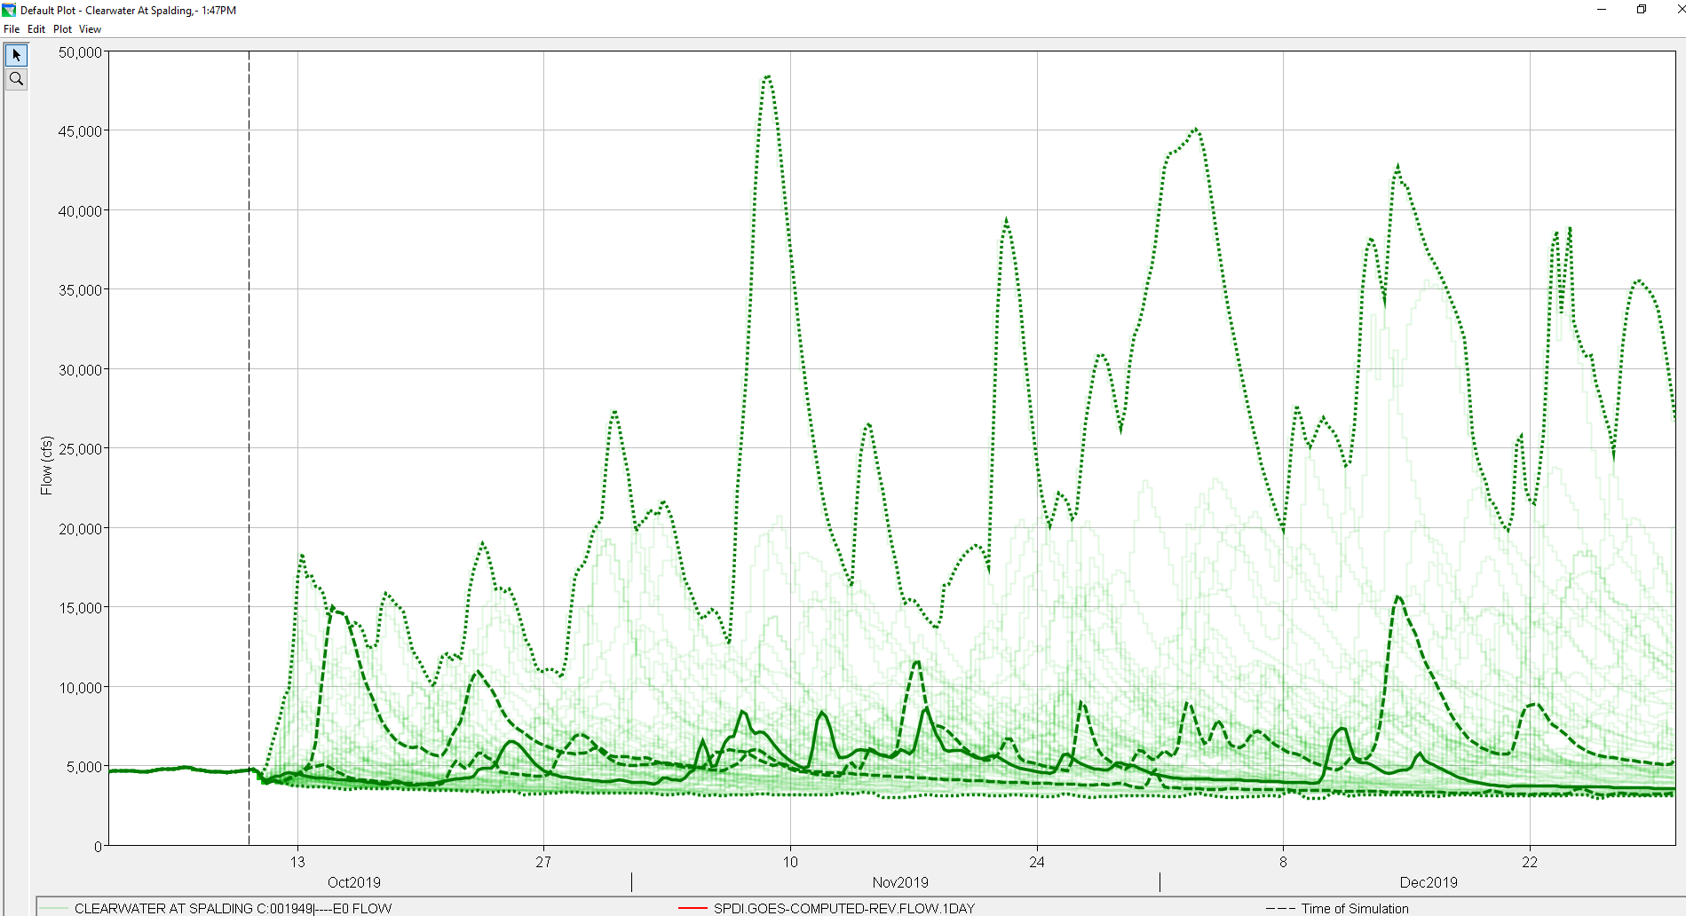
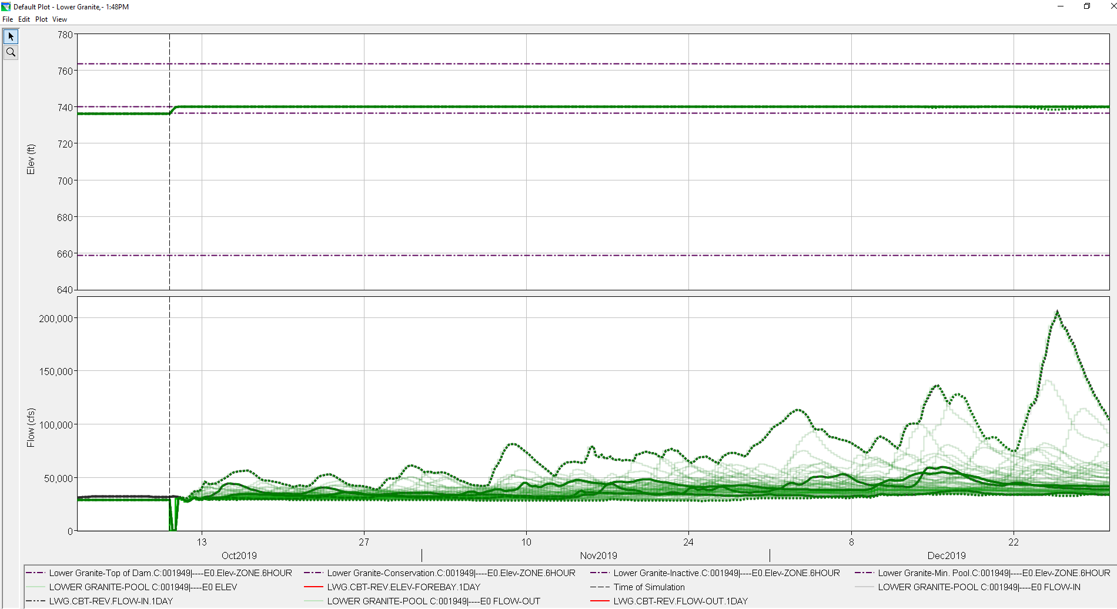
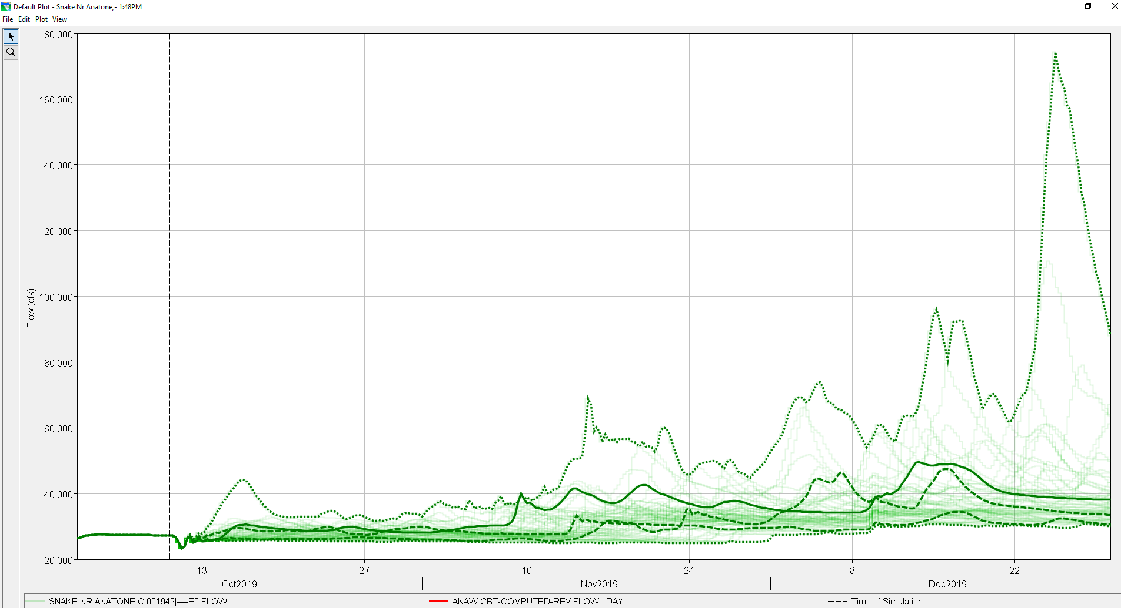
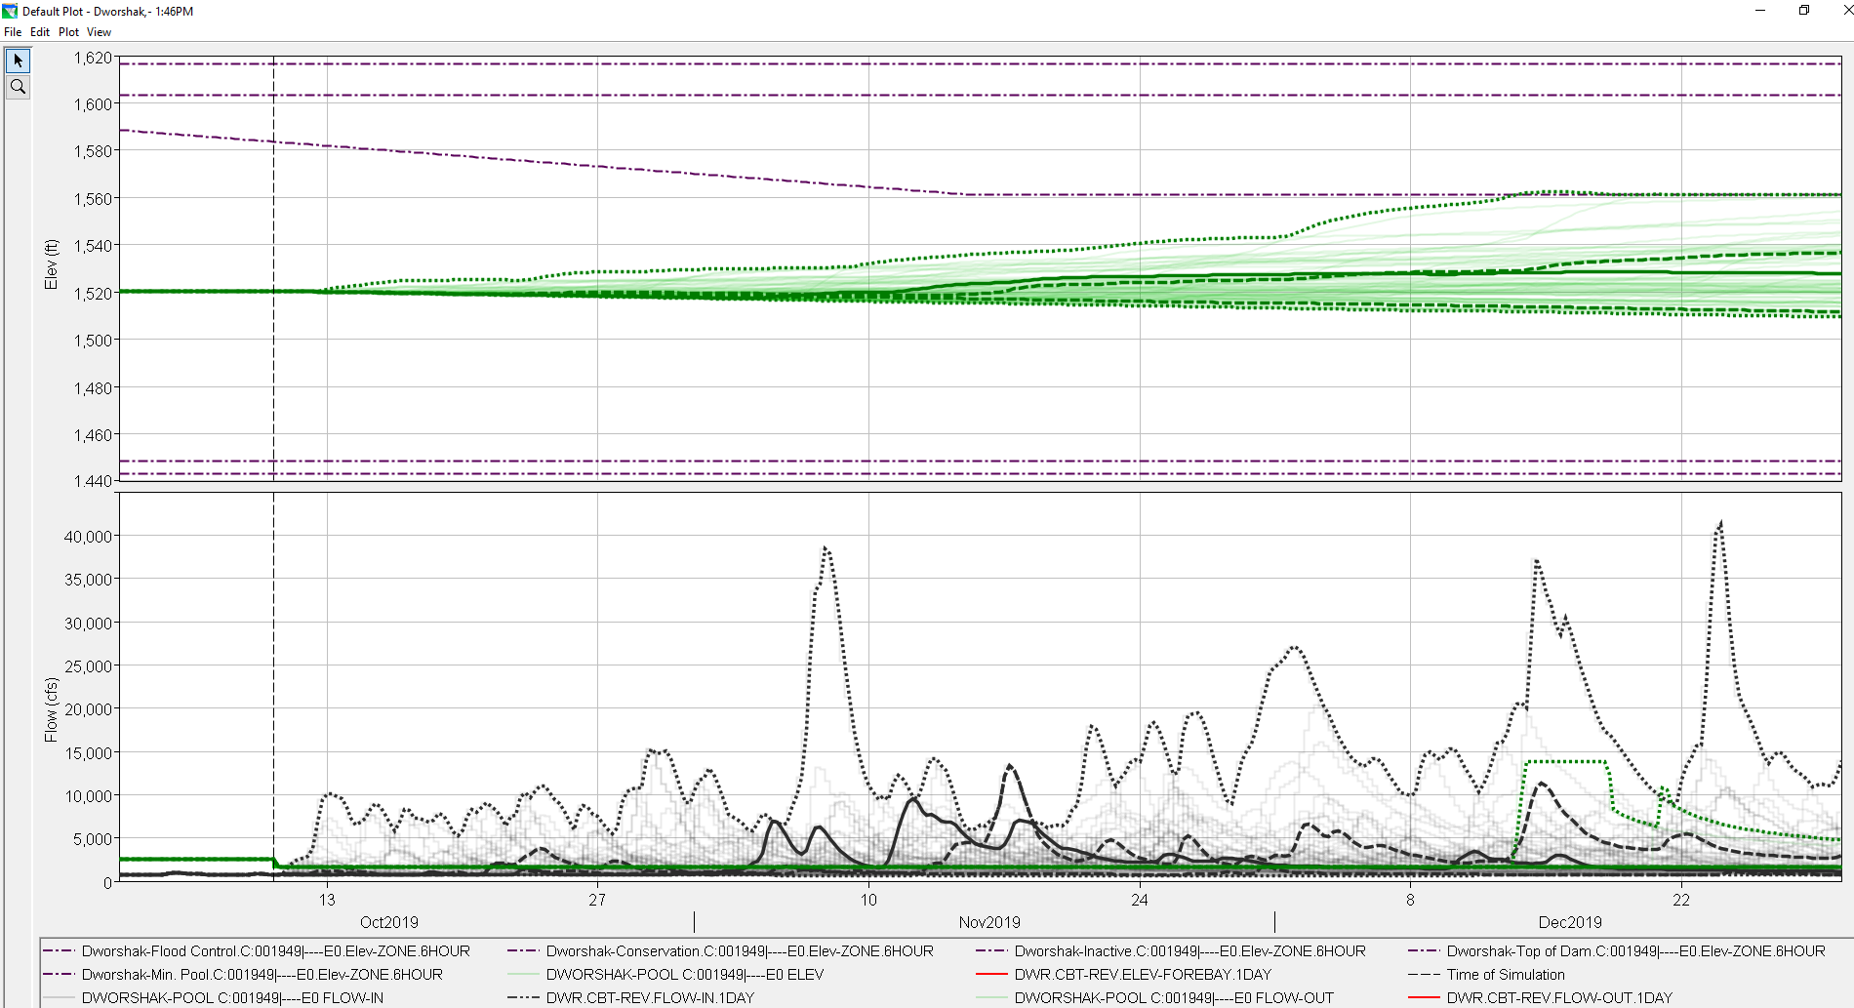
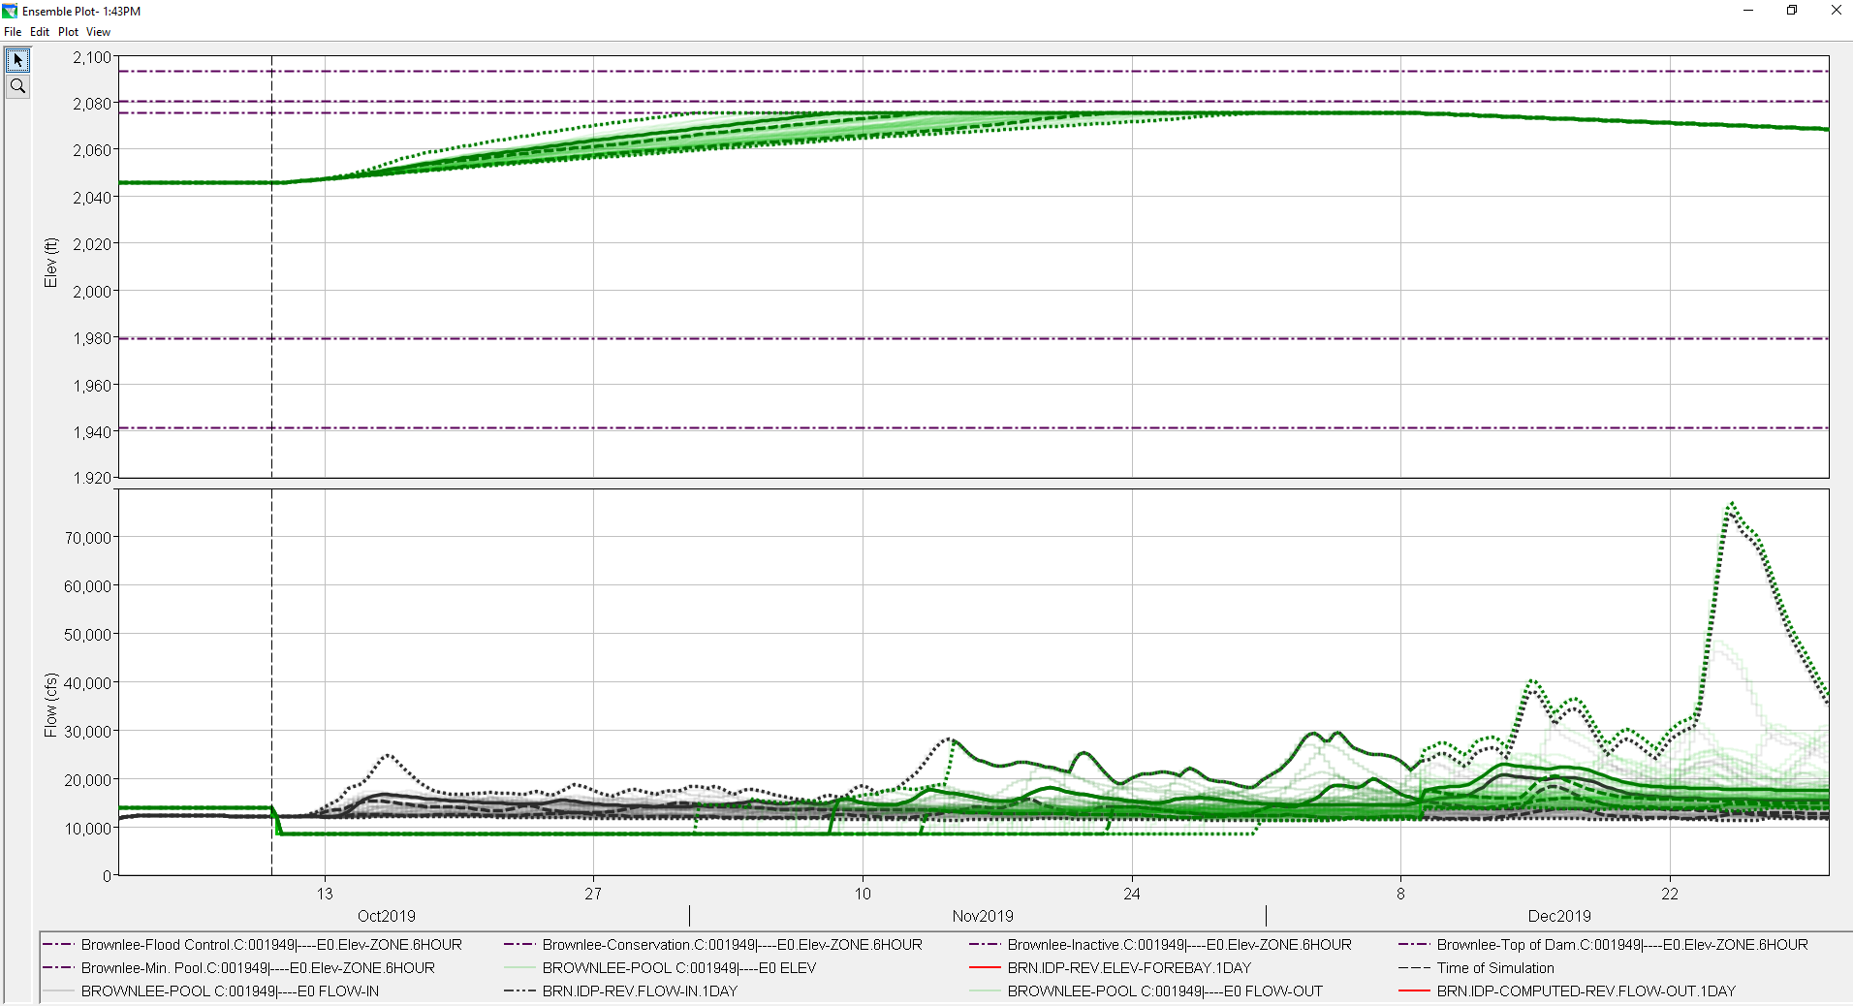
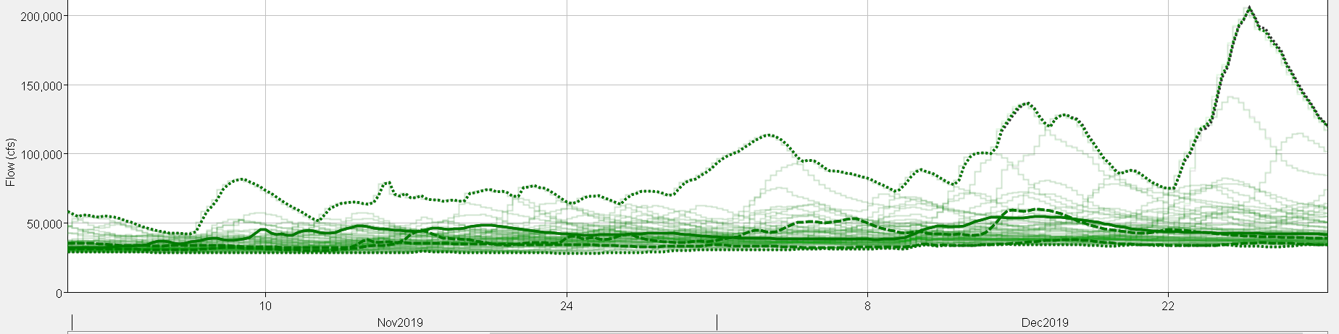
CAVI Results

Slide 11
Future Improvements and Partnership
Graphic Interface
  Weighting of ESP trace based on WY Forecast
  Highlighting of 10/90% bands
  Highlighting of specific water analog years
Partnership with NWRFC
  Improving how data is handed off
  Adding a 10-day observed period to ESP traces
  Handing regulation runs back to NWRFC for downstream control points (current proposal is at the LWG inflow point)

Slide 12
Questions?

Slide 13
Ice Harbor_IN
LwSnakeRv_S110
Snake+Palouse
LwSnakeRv_S130_Local
PalouseRv_R10
ResSim: Standard CWMS Network Setup
Potlatch nr Spaldng
PotlatchRv_S10
Lower Monumental_IN
LwSnakeRv_S120
Clearwater at RM 29.68
ClearWaterRv_S20
Dworshak_IN
DWR_Inflowl
Lower Granite_IN
LwSnakeRv_S150_Local
Columbia+Snake
LwSnakeRv_S100
Tucannon_HW
TucannonRv_S10
Little Goose_IN
LwSnakeRv_S140_Local
Snake+Clearwater
ClearWaterRv_S10_Local
Clearwater at Orofino
LwSnakeRv_S150_Local
Snake+Asotin
LwSnakeRv_S170
Clearwater at Spalding
LwSnakeRv_S150_Local
Snake near Anatone
Lapwai Ck near Lapwai
LwSnakeRv_S150_Local
Asotin Ck
AsotinCk_S10
Snake bl McDuff Rapids
LwSnakeRv_S180_Local
Snake+Grande Ronde
GrandRondeRv_R10
Snake+Salmon
SalmonRv_R100
ResSim Model Reach
Hells Canyon
Reach Not Modeled
Snake+Imnaha
Imnaha_Rv_R10
LwSnakeRv_S190_Local
Oxbow
*All inflows computed by HMS
**Not all CCPs displayed
Non-Inflow CCP
Brownlee_IN
Brownlee_Inflow
CCP Inflow Location

Slide 14
Tucannon near Starbuck
USGS 13344500
ResSim: ESP Network Setup
HOPW1
Palouse at Hooper (unreg)
IHDW1
Ice Harbor (local)
DWRI1
Dworshak (unreg)
LMNW1
Lower Monumental (local)
LGDW1
Lower Granite (local)
PRII1
Potlatch below Little Potlatch
LGSW1
Little Goose (local)
SPDI1
Clearwater at Spalding (local)
ORFI1
Clearwater at Orofino
Inflow Equations to Properly Account for Mass Balance:
*These are total flows, produced by RFC and used as boundary conditions
BRNI1, ORFI1, DWRI1, PRII1, HOPW1
*These are routing calcs for local flows
ANAW1_{local} = ANAW1_{total} – HCDI1_{total,routed} (note: HCDI1_{total} =BRNII1_{total})
LGDW1_{local} = LGDW1_{total} – ANAW1_{total,routed} – SPDI1_{total,routed} -0.16*IMNO3_{total,routed,Asotin} (Note: 0.16*IMNO3 = Asotin)
SPDI1_{local} = SPDI1_{total} –PRII1_{total,routed}– 0.14PRII1_{total,routed,Lapwai}– ORFI1_{total,routed} – DWRI1_{total,routed}
LGSW1_{local} = LGSW1_{total} - LGDW1_{total,routed}
LMNW1_{local} = LMNW1_{total} – LGSW1_{total,routed} – HOPW1_{total,routed} – 0.15*HOPW1_{total,routed,Tucannon}
IHRW1_{local} = IHRW1_{total} – LMNW1_{total,routed}
*These are relationships of locations without ESP data to locations with ESP data
**These are also routed in the local flow calculations
Lapwai Ck near Lapwai = 0.14*PRII1
Tucannon near Starbuck = 0.15*HOPW1
Asotin Ck = 0.16*IMNO3
Asotin Ck at Asotin
USGS 13335050
ANAW1
Snake near Anatone (local)
Lapwai Ck near Lapwai
USGS 13342450
TRYO3
Grande Ronde at Troy
WHBI1
Salmon at Whitebird
RFC Routing Reach
IMNO3
Imnaha at Imnaha
ResSim Model Reach
HCDI1
Hells Canyon (unreg)
Reach Not Modeled
RFC Forecast Location
CCP Inflow Location
Non-RFC Forecast Location; inflows to be computed in relation to RFC Location
BRNI1
Brownlee (unreg)
*BRNI1 = HCDI1 RFC flows

Slide 15
Snake+Palouse
ResSim: Routing Table Names
Ice Harbor_IN
Snake+Tucannon
snk_to_40_96
Little Goose_IN
Clearwater+NF
snk_to_9_34
RM92.02
Clearwater nr Peck
Lower Granite_IN
Potlatch nr Spaldng
Clearwater at RM 29.68
Lower Monumental_IN
snk_to_58_74
Snake+Clearwater
Clearwater + Potatch
nf_cw_to_0_17
Clearwater at Spalding
Dworshak_OUT
snk_to_61_82
Dworshak_IN
Columbia+Snake
Tucannon_HW
snk_to_69_77
cw_to_37_45
cw_to_40_71
snk_to_92_02
cw_to_15_19
snk_to_106_15
cw_to_0_24
cw_to_11_84
cw_to_29_93
Clearwater at Orofino
snk_to_137_56
cw_to_3_94
NULL routing
lap_to_0_23
snk_to_143_67
Snake+Asotin
snk_to_165_87
Snake near Anatone
Lapwai Ck near Lapwai
Asotin Ck
Snake+Grande Ronde
snk_to_167_03
Snake bl McDuff Rapids
snk_to_174_04
Snake RM178.27
snk_to_177_48
Snake+Salmon
snk_to_186_42
Snake+Imnaha
snk_to_189_89
Snake at Johnson Bar
ResSim Model Reach
snk_to_227_66
Hells Canyon
Reach Not Modeled
Brownlee Flows = Hells Canyon Flows (NULL routing in ESP traces)
Oxbow
Non-Inflow CCP
Brownlee_IN
CCP Inflow Location

